Slide 1
Ensemble clustering methods
Shrayes Ramesh

Slide 2
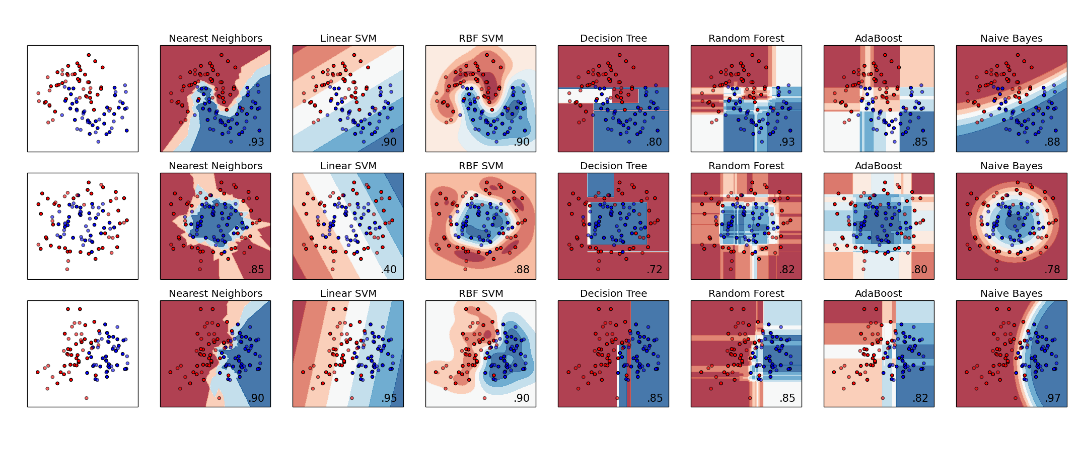
Intro: classification versus clustering
Classification:
Build a model that assigns a data point its best label
Data points colored by “ground truth” labels red and blue
From scikit-learn.org

Slide 3
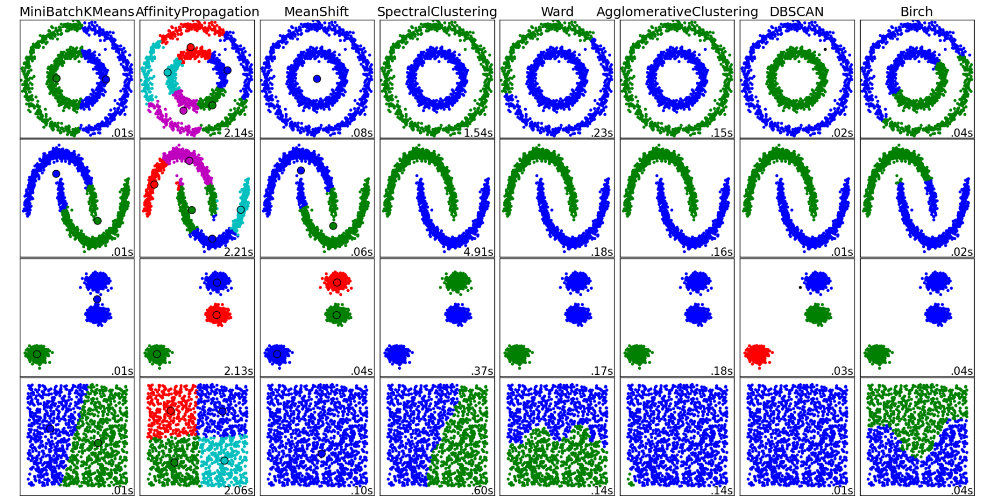
Intro: classification versus clustering
Clustering:
Build a model that groups data into clusters
Note: there is no ground truth / ground truth is not known apriori
The algorithm chooses a partitioning that “makes sense”
From scikit-learn.org

Slide 4
Intro: why clustering?
Big, distributed data sets: store everything, know nothing
Detecting behaviors for exploratory analysis: let’s start somewhere smaller (in parallel)
Unsupervised learning of patterns-of-life: wait, don’t we do “machine learning?”
1
2
3
4
5
6
…
1
4
5
…
Logical database partitions
2
3
6
…
Distributed dataset
1
4
5
…
Groups of users
Groups of employees
…
1
2
3
4
5
6
…
2
3
6
…
Data from all users, employees

Slide 5
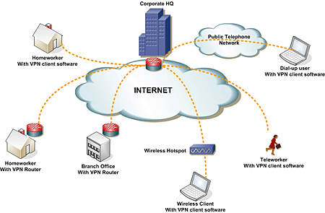
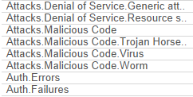
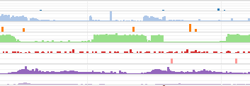
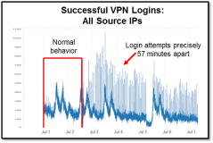
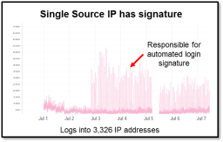
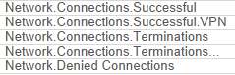
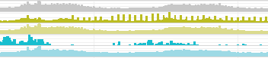
Network Defense program
Detecting network infiltration via distributed computation that identifies anomalous behavior
Agency HQ
Homeworker with
VPN client software
Netflow and log data
Homeworker with VPN router
100s of office locations
Teleworker with VPN client software
Wireless VPN client
VPN = Virtual Private Network
Rule-based signatures Adaptive behavior detection
Stateless single IP analyses Context-based decisions
Manual analysis Guided automation
Visual inspection
Visual inspection aided by distributed analytics
Automated response to known threats, suspicious periods flagged
Jun 30 18:57:01 172.28.215.239 IPSEC: An outbound LAN-to-LAN SA (SPI= 0xA75FC985) between xxx.xxx.xxx.xxx and yyy.yyy.yyy.yyy created.

Slide 6
“Small data” clustering
Hierarchical clustering works great for small data
These algorithms are O(N^2) requiring computation of N^2 distances
They will not scale well
Most (not all) algorithms that do dimensionality reduction, produce dendrograms, learn manifolds, or construct 2d projections are also O(N^2)

Slide 7
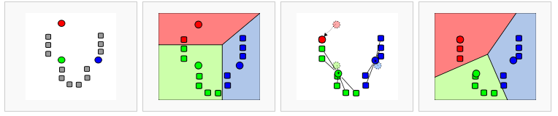
Scalable clustering in a MapReduce world
E-M approaches (like k-means) are embarrassingly parallel per iteration
But they only produce local optima
Initialize centroids
Assign each point to nearest centroid ; O(N*K)
Group data into clusters, recompute centroids
Repeat until convergence
Other O(N*K) mixture models estimated with sampling procedures tend to require lots of O(N*K) iterations (aka MR jobs/tasks) to converge
But…
What if the features are distributed or high dimensional?
Notes:
Inferences about a population from a sample
Can’t we run a whole bunch of kmeans and pick the best one?

Slide 8
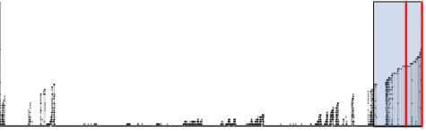
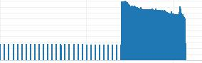
Detecting infiltrator conducting reconnaissance
Approach: Identify IP addresses that behave differently from others
5.2 billion communications
750 million communications between IP address pairs
530 thousand summarized connections
Raw data:
Source IP address
Destination IP address
Bytes
Packets
Port
Protocol
Data
60 iterations of 3 clustering algorithms consolidated via “voting procedure”
Ranked list of outliers
Reachability Distance
Outliers
Algorithms
IP Addresses
IP address conducts recon on 9683 IP addresses from inside network
Investigated two extreme outliers out of 4.6 billion IP addresses
Identified potentially compromised IP address
Outcome
Bytes per hour
Time
Notes:
Protoport counts <IP, (direction-protocol-port), total count>
Graph features <IP1, IP2, total bytes>

Slide 9
Ensemble Clustering: Motivation
Scalability and Robustness
Problem: “accurate” clustering algorithms are > O(N^2)
Typical solutions: E-M or O(K*N) clustering at scale
However: many fast clustering algorithms give local minima
Problem: data sets are high dimensional or distributed
Typical solution: repeated sampling or subsetting before clustering
However: unlike an ensemble of classifiers, cluster labels don’t align
References
Strehl, A., & Ghosh, J. (2003). Cluster ensembles---a knowledge reuse framework for combining multiple partitions. The Journal of Machine Learning Research, 3, 583-617.
Fred, A. L., & Jain, A. K. (2005). Combining multiple clusterings using evidence accumulation. Pattern Analysis and Machine Intelligence, IEEE Transactions on, 27(6), 835-850.
Topchy, A., Jain, A. K., & Punch, W. (2005). Clustering ensembles: Models of consensus and weak partitions. Pattern Analysis and Machine Intelligence, IEEE Transactions on, 27(12), 1866-1881.

Slide 10
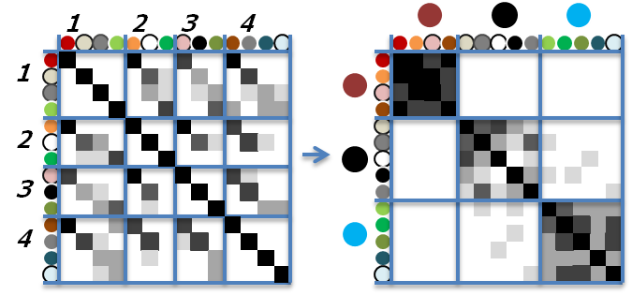
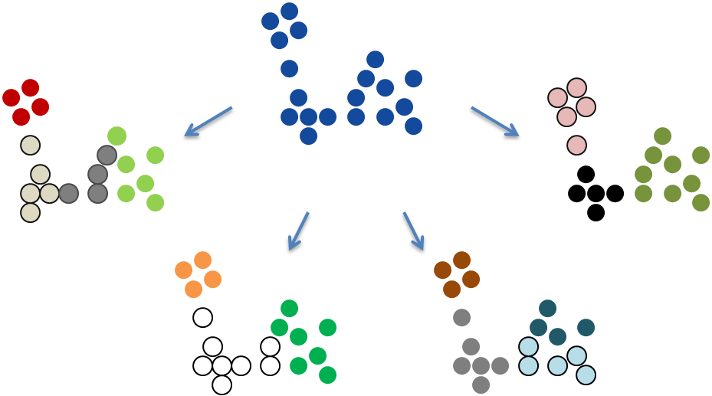
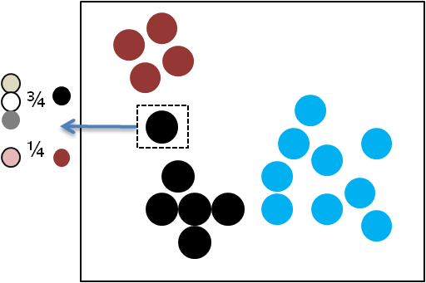
Ensemble Clustering: One Slide Overview
Cluster to generate initial partitions
Align clusters into metaclusters
Vote for final clusters

Slide 11
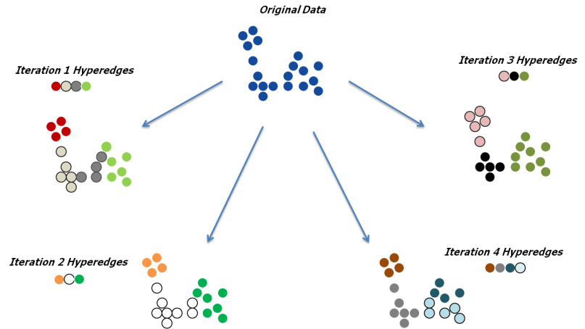
Generating an ensemble of clustering partitions
Cluster to generate initial partitions
First stage clusters: the set of points tagged with the same color are called a “hyperedge”

Slide 12
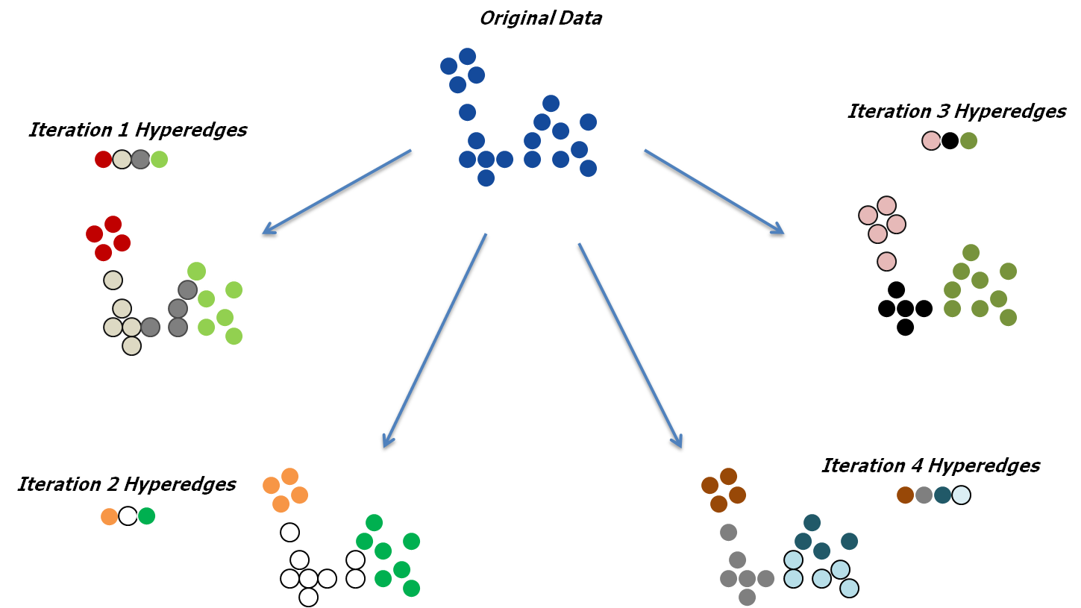
First-stage clusters (hyperedges) don’t align
Problem:
cluster labels (hyperedges) differ across iterations
Solution: cluster the hyperedges by the set of data points they have in common
Solve smaller O(n^2) problem
1
2
3
4
1
1
2
2
3
2. Compute smaller (than N) hyperedge similarity matrix
4

Slide 13
Second-stage clustering to produce metaclusters
4. Each point choose a final metacluster by voting
¾
¼
3. Clustering hyperedges into “metaclusters”
1
2
3
4
1
2
3
4

Slide 14
Decision points: first and second stage clustering
The algorithm chosen in the generation of clustering assignments matters
Dataset
id
feature1 feature2 feature3 feature4
1
2
Overlapping samples:
Cluster a random partition of the dataset
Each point needs to be in multiple partitions
3
4
5
…
Distribute by feature:
Cluster the entire dataset by different subsets of features
Bootstrap samples:
Cluster a random partition of the dataset; output “predictive models”
Assign all points to predicted cluster labels

Slide 15
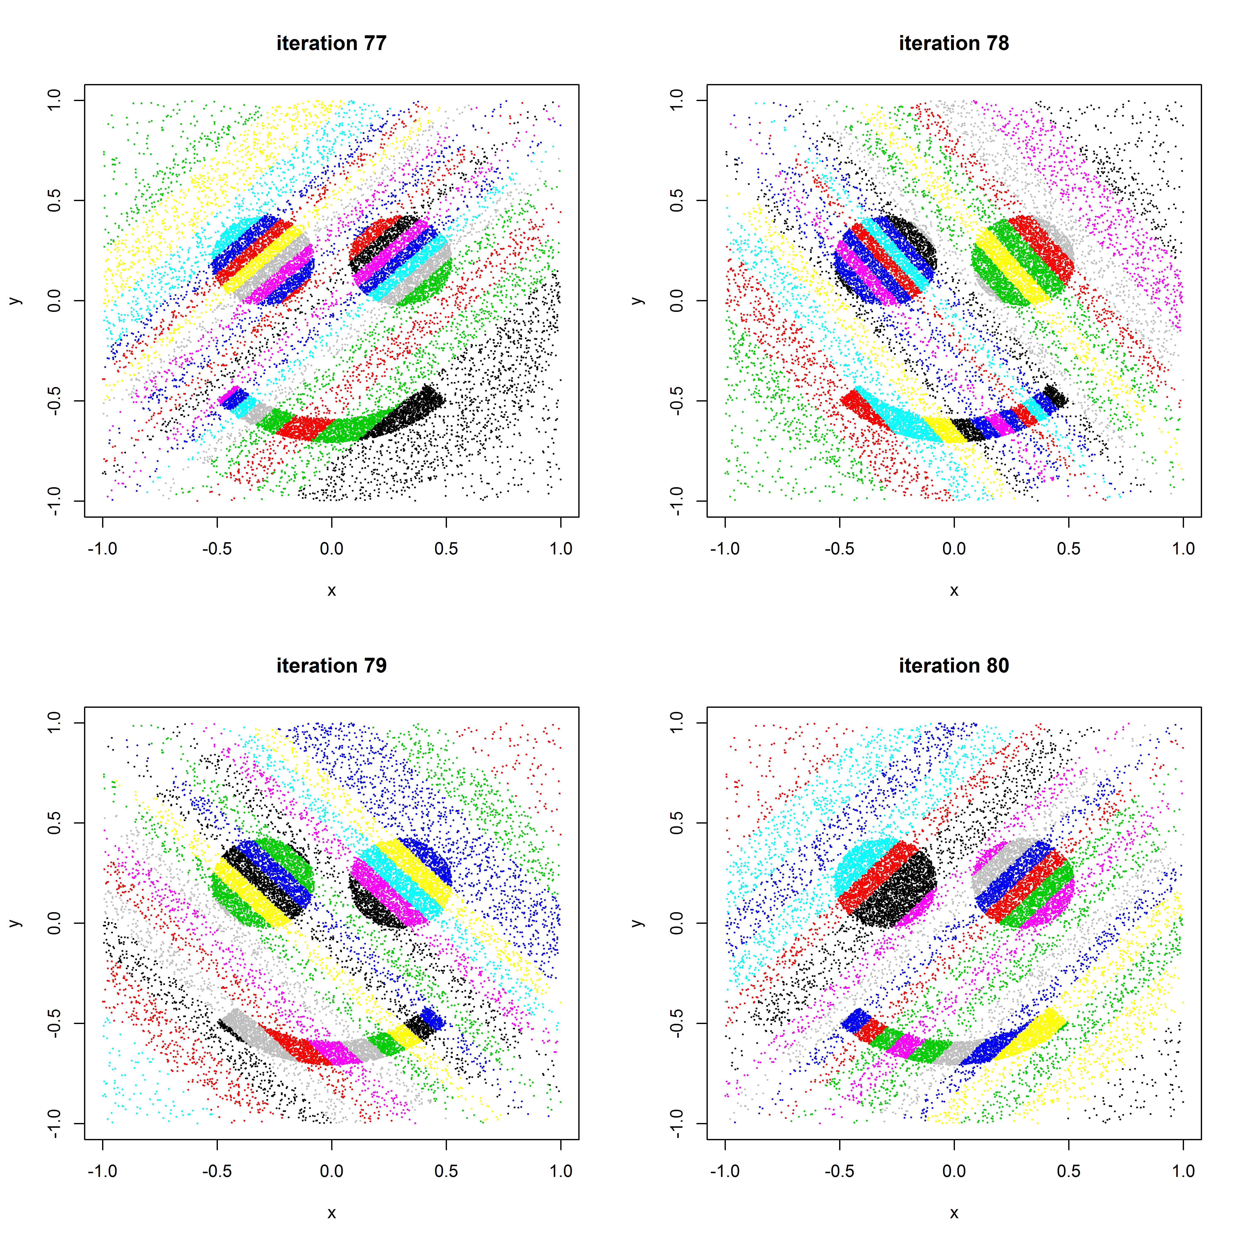
Walkthrough: ensemble clustering on 20k smiley face
Workflow:
Draw a random multivariate normal vector r ~ N(0,I)
Project data: y = x*r
k-means on y (k=20)
Repeat many times (80)
Output is first stage cluster assignments:
(node; iteration; label)
Random projection kmeans first stage clusters (last four iterations)

Slide 16
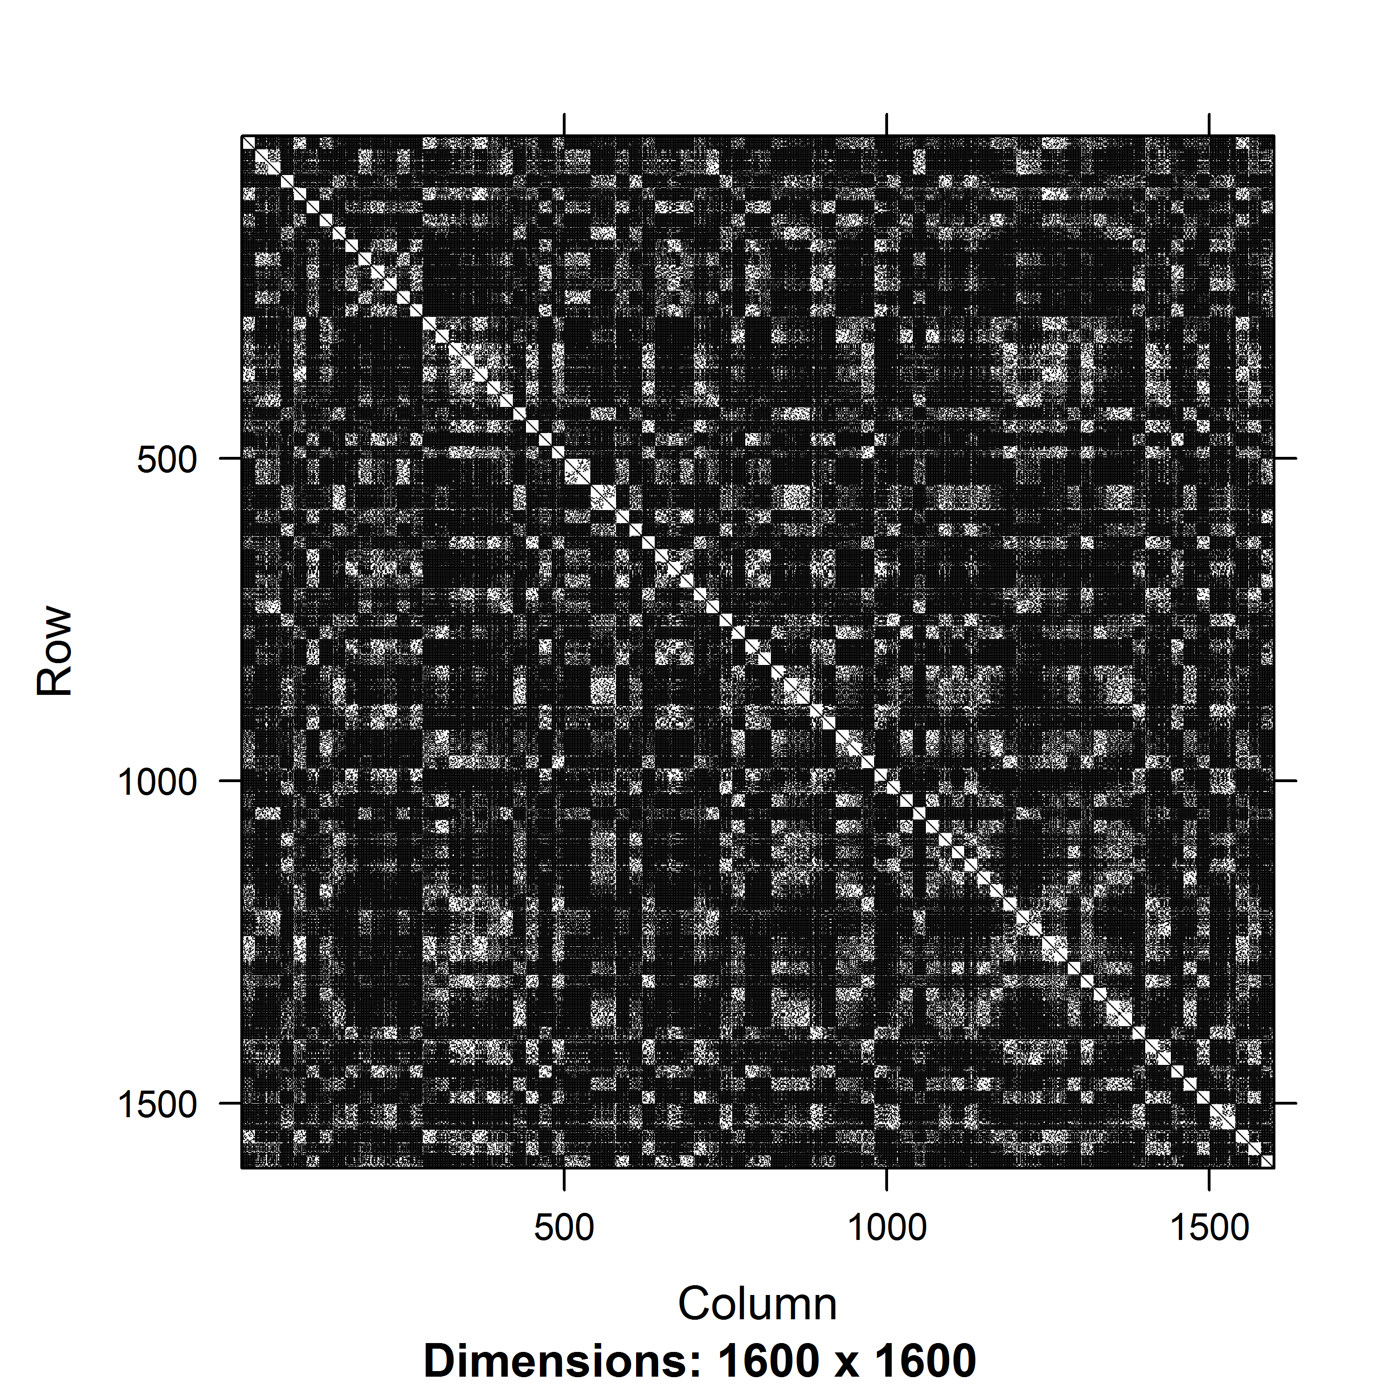
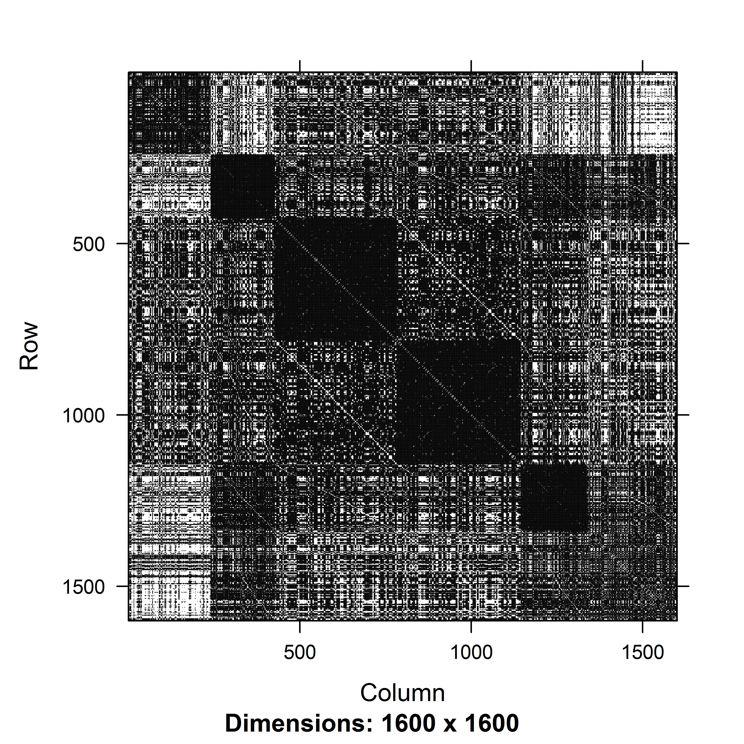
Metaclustering
First stage clusters: 20 clusters x 80 iterations
Colored by number of points in common
20 clusters per iteration
Metaclusters
80 iterations
Spectral clustering
k= 6

Slide 17
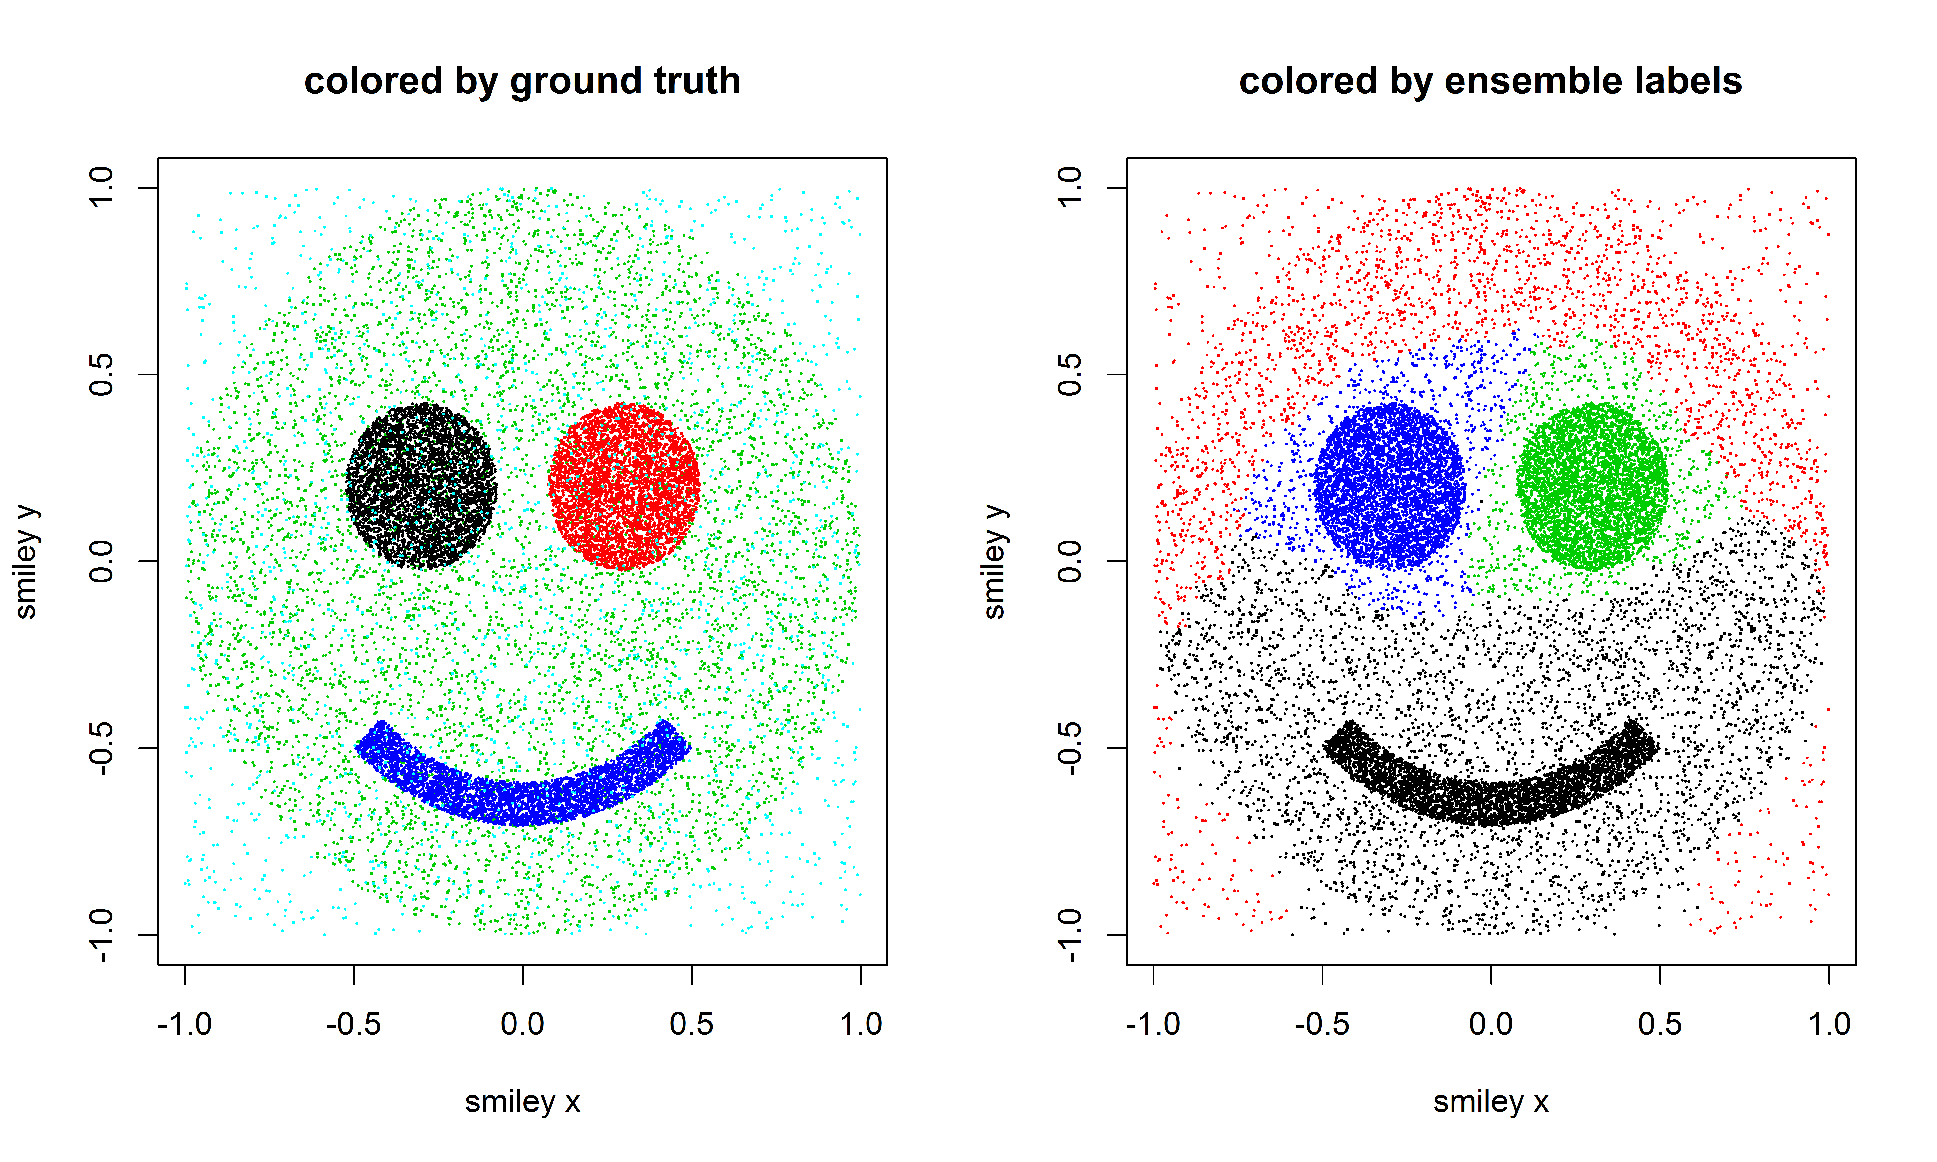
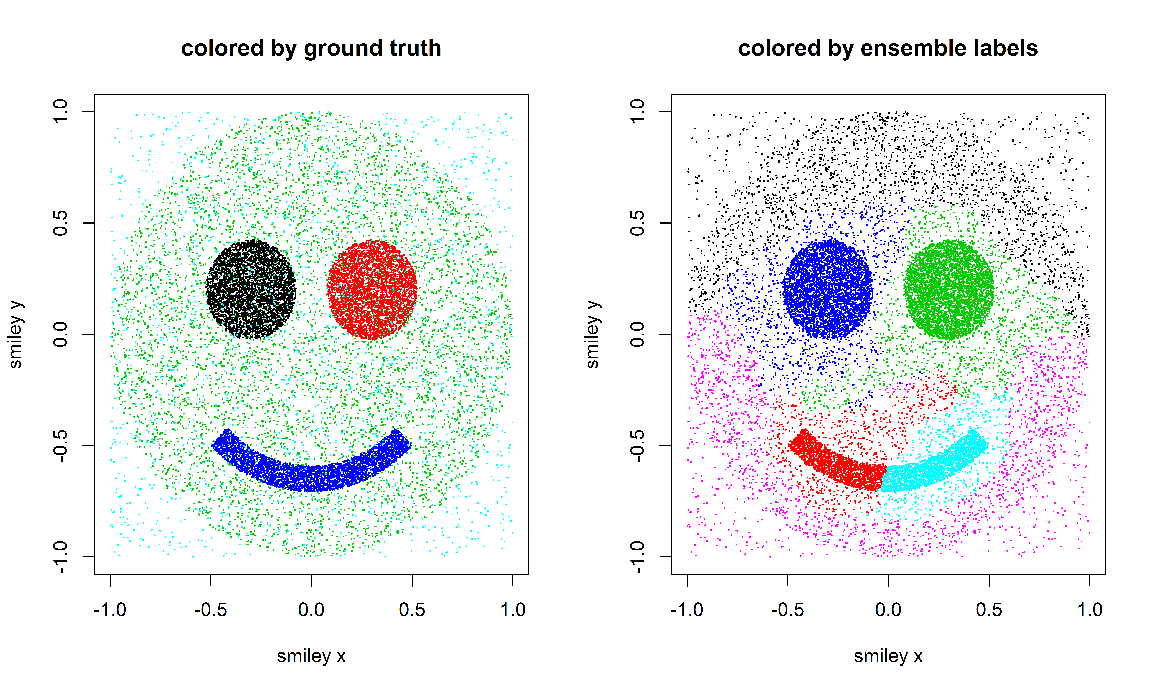
Voting
K=4
From convex first stage clusters to nonconvex metaclusters
K=6

Slide 18
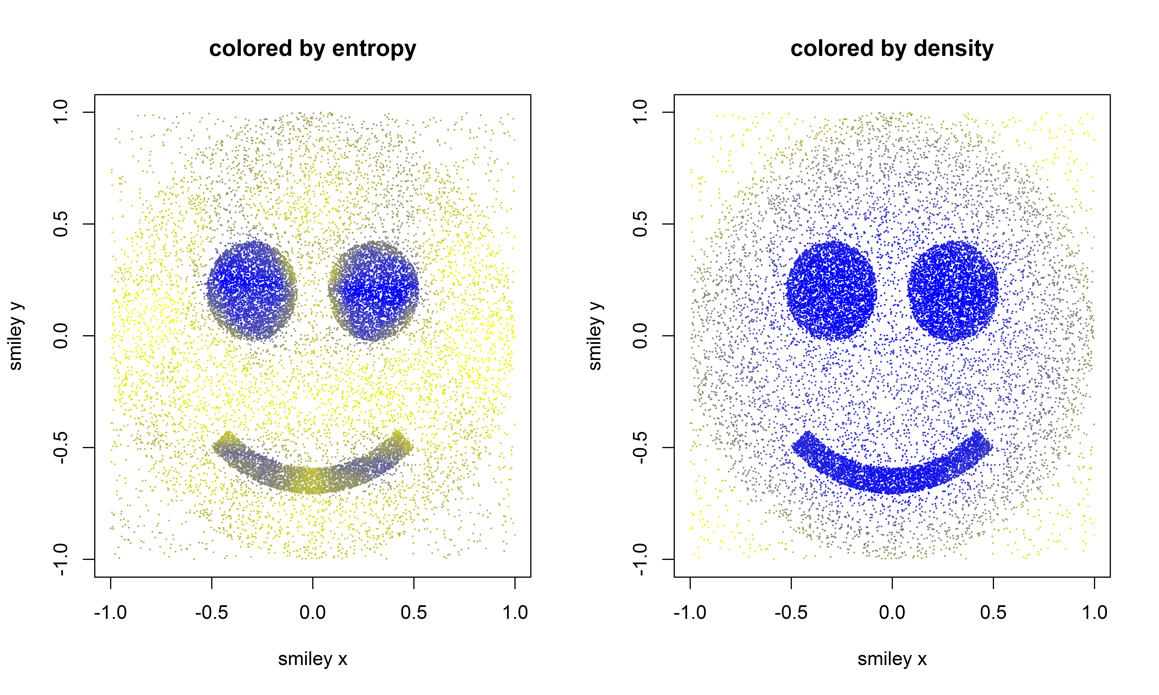
Extensions: entropy and density
Entropy:
To what extent do your first stage clusters agree?
Density:
On average, how many other points are in your bin?
¾
¼
High density
Easy to cluster
Low density
Hard to cluster

Slide 19
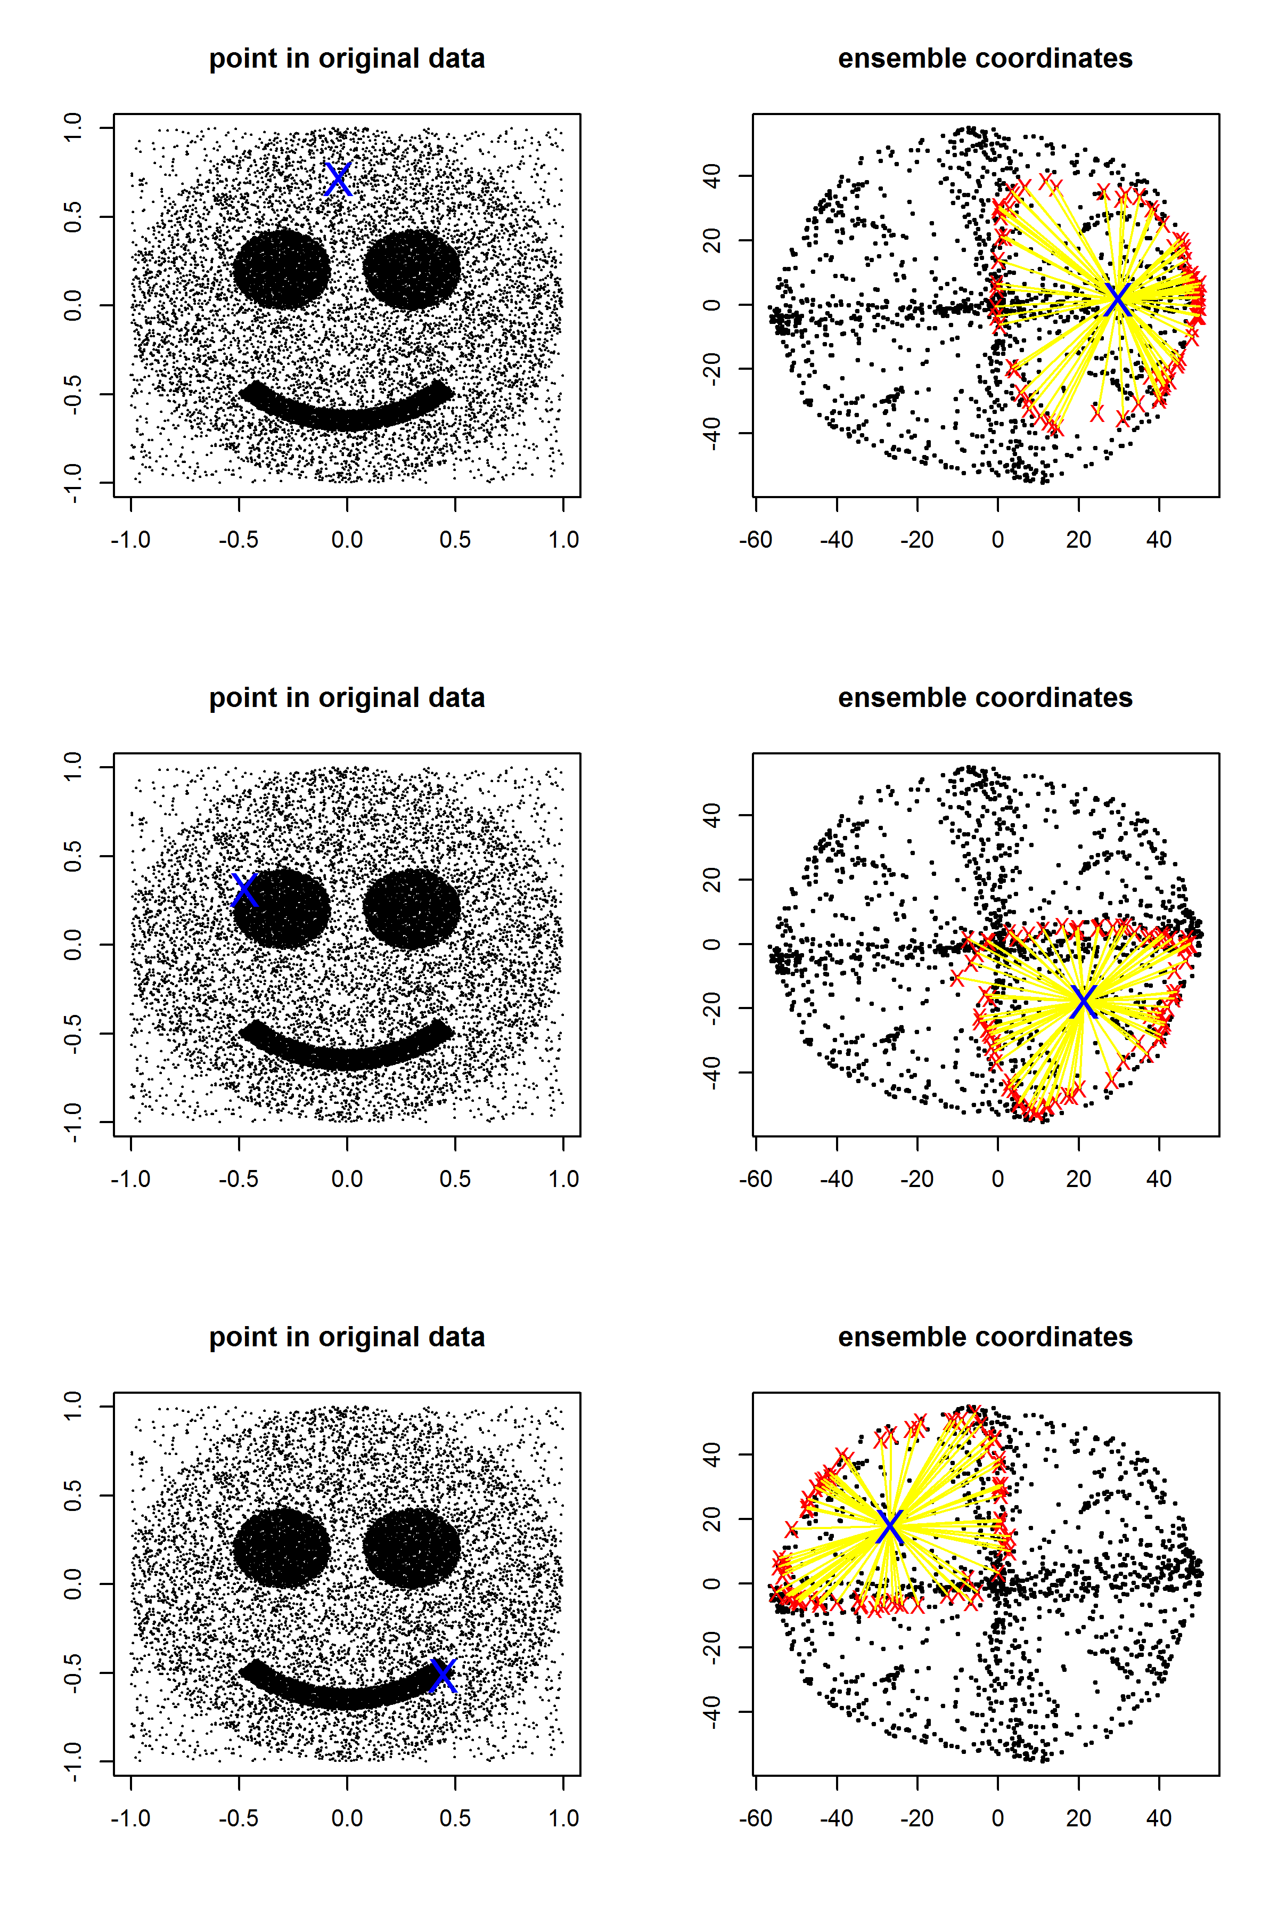
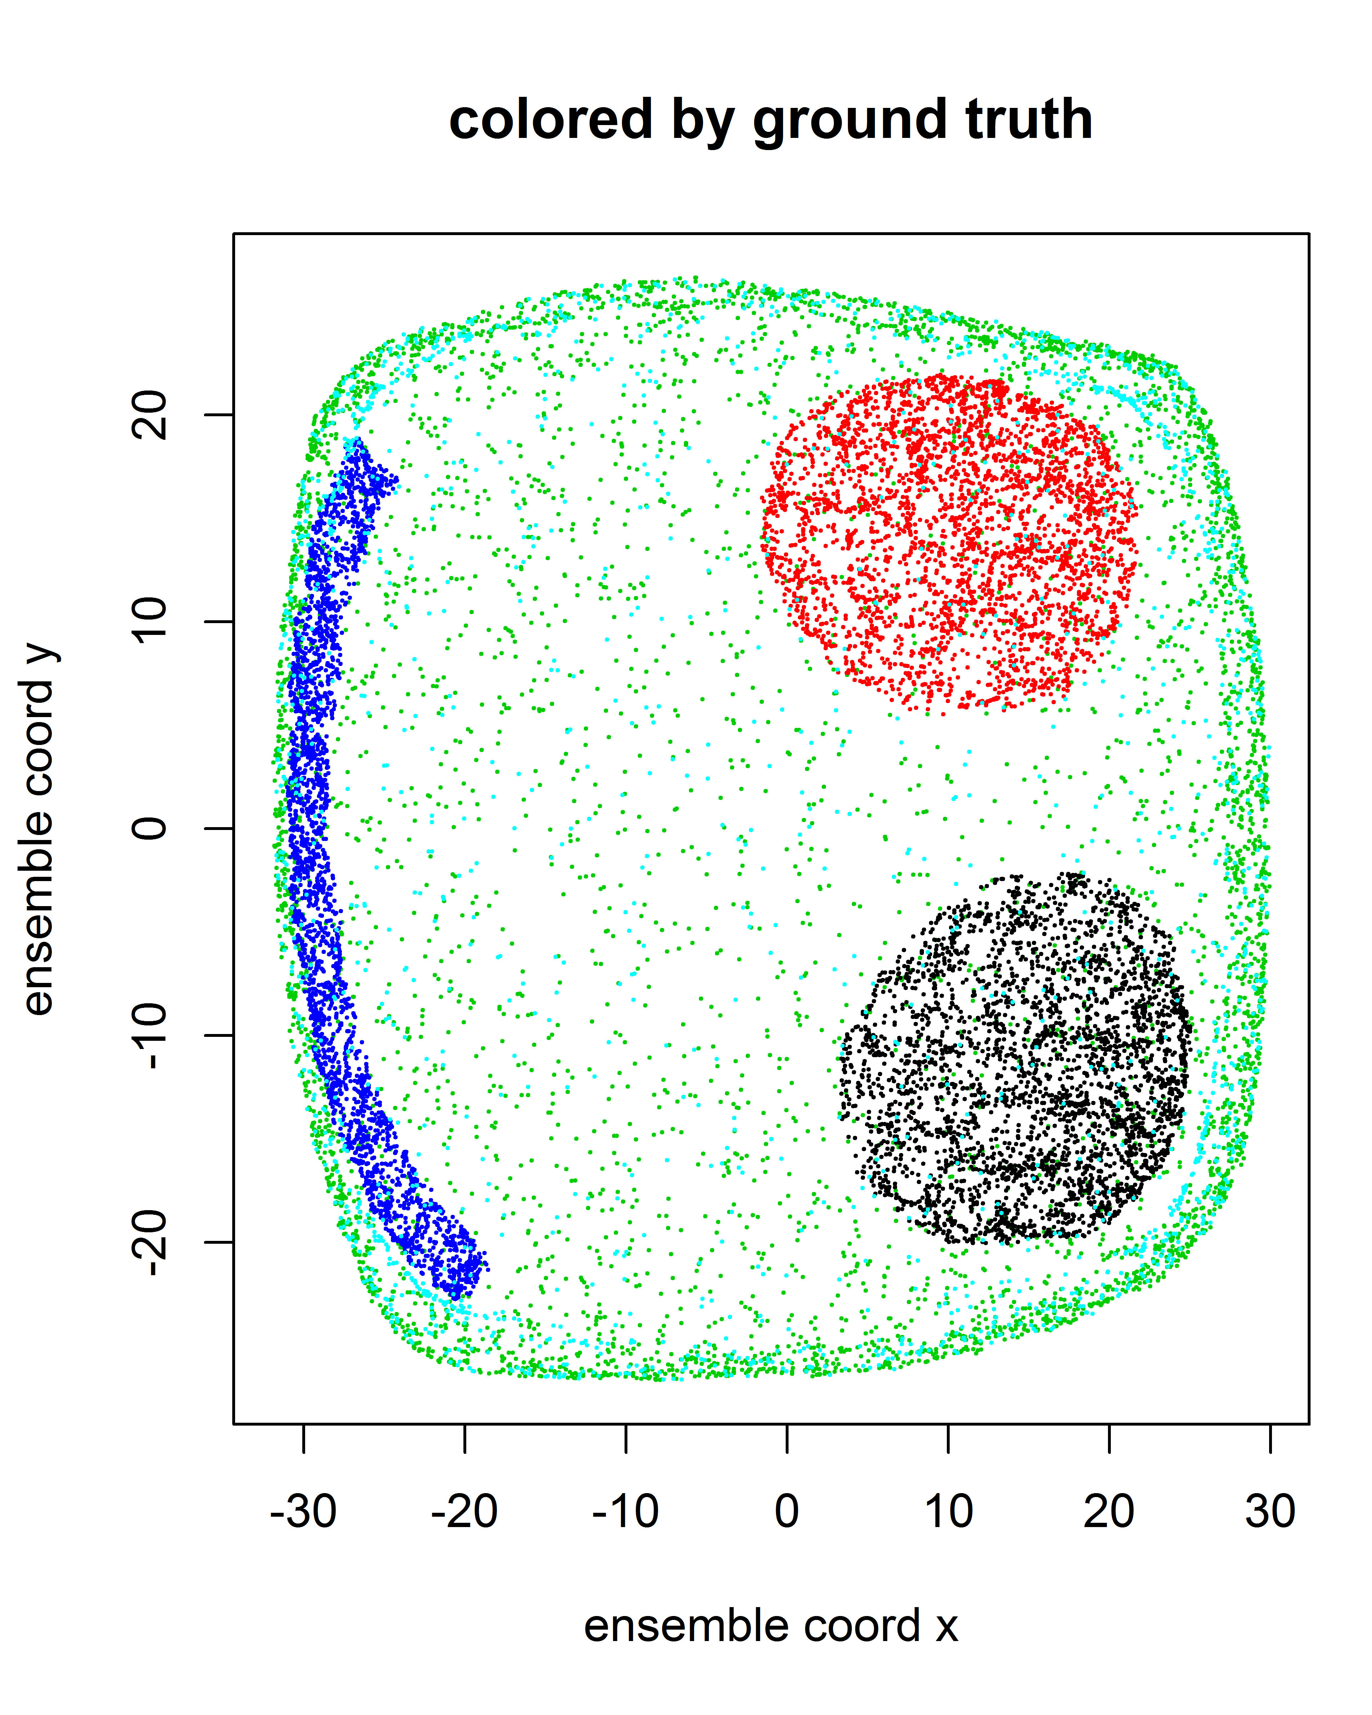
Extension: ensemble topology visualizations
First stage clusters
Metaclusters
Spectral clustering
Classical multidimensional scaling
Point’s coordinate = average coordinate of its clusters

Slide 20
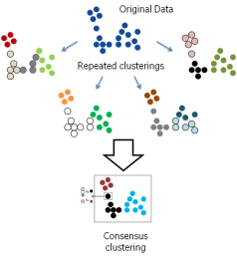
Workflow: categorizing 237k song lyrics
musiXmatch dataset, the official lyrics collection for the Million Song Dataset, available at: http://labrosa.ee.columbia.edu/millionsong/musixmatch
1m song database:
trackid
artist
song
album
year
237k song DTM:
trackid
stemmed word (top 5000)
count
Hypothetical questions
Can we learn “genres” from examining song lyrics alone?
Can we identify when genres emerge and peak over time?
Can we quickly visualize the landscape of song lyrics?
Can we track how artists evolve over time?
Abc
Abc
Abc
Abc
Abc
Abc
Abc
Abc
Abc
Abc
Abc
Abc
#
#
#
#
#
#
Ensemble Clustering
50 iterations of spherical k-means (cosine similarity) with k=20
In [R], using just slam, Matrix and doParallel
Ensembled together with spectral clustering, k=12
With ensemble visualization
Joined/aligned with metadata on year, artist

Slide 21
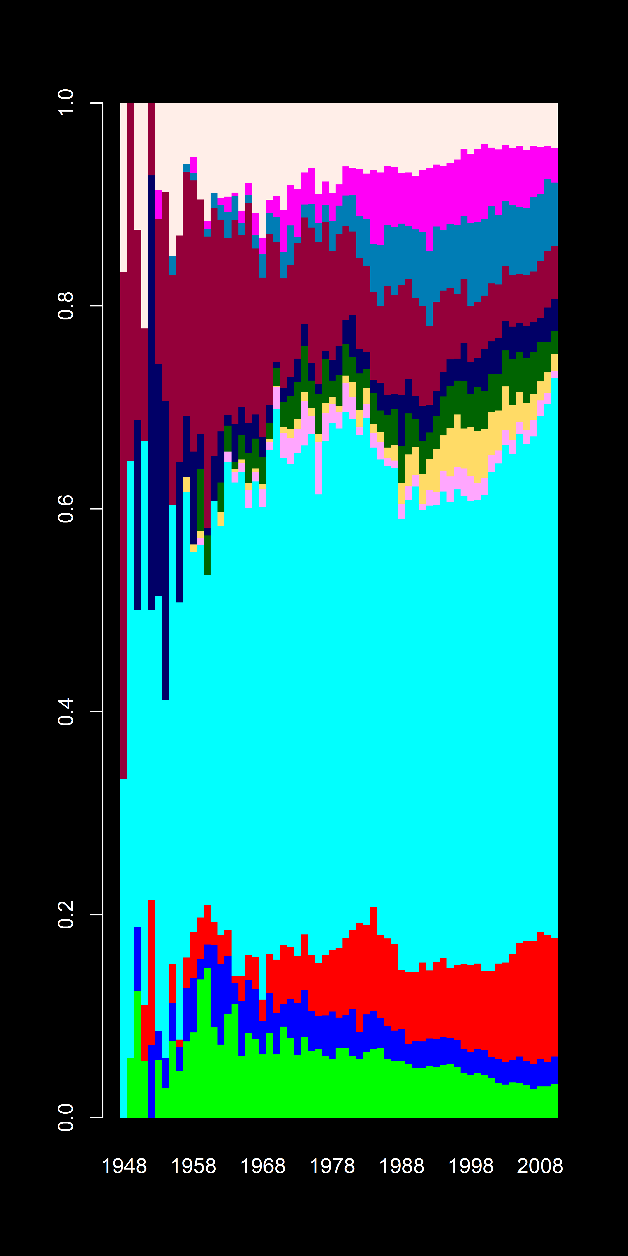
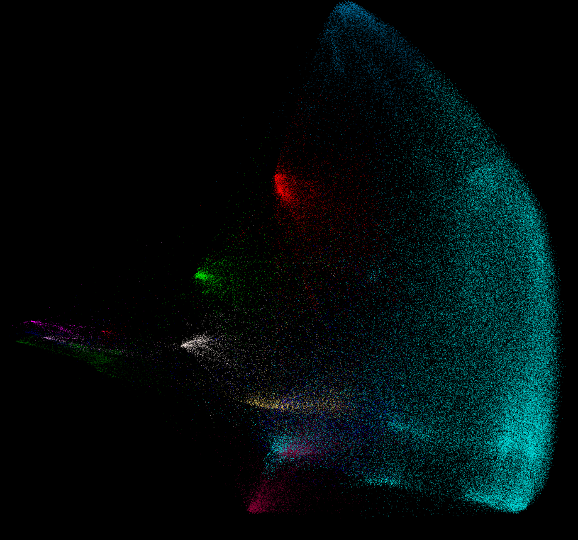
Application: clustering 237k song lyrics
Cluster % over time
"she" "her" "i" "the" "girl"
"que" "y" "de" "la" "el"
"of" "the" "death" "blood" "their"
"love" "babi" "you" "i" "me"
"je" "de" "et" "les" "le"
"na" "o" "eu" "e" "nÃ£o"
"n****" "f***" "s***" "i" "ya"
"che" "e" "di" "non" "il"
“i" "you" "am" "the" "not"
"we" "ich" "our" "und" "are"
"hey" "gonna" "wanna" "you" "i"
"he" "his" "him" "the" "was"
Ensemble layout (colored by clusters)

Slide 22
Thank you!
Shrayes Ramesh
shrayes.ramesh@gmail.com
www.github.com/shrayesramesh

